Slide 1
15-440 Distributed Systems
Lecture 11 – Distributed Concurrency Management
Tuesday Oct 5th, 2015

Slide 2
Logistics Updates
P1 checkpoint 1 due today (11:59EST, Oct 6th)
  Final Submission: 11:59pm EST, Oct 16th
HW2 released today
  Due Oct 15th (*No Late Days*).
Mid term Tuesday Oct 20th in class

Slide 3
Today's Lecture Outline
Consistency for multiple-objects, multiple-servers
Part I: Single Server Case
  (not covered well in book)
  Two Phase Locking
Part II: Distributed Transactions
  Two Phase Commit (Tanenbaum 8.6)

Slide 4
Distributed Consistency Management
Multiple-Objects, Multiple Distributed Servers
Assumption: We will ignore failures
  In the context of today's consistency mechanisms, for fault tolerance, most systems use a form of logging, where they write information down *before* operating on it, to recover from simple failures.
  We will talk about failure/recovery later on in class

Slide 5
Case I: Single Server
Background: Database Researchers
Defined: “Transactions”
  Collections of Reads + Writes to Global State
  Appear as a single, “indivisible” operation
  Standard Models for Reliable Storage (visit later)
Desirable Characteristics of Transactions
  Atomicity, Consistency, Isolation, Durability
  Also referred to as the “ACID” Acronym!
Notes:
Database researchers laid the background for reasoning about how to process a number of concurrent events that update some shared global state. They invented the concept of a "transaction" in which a collection of reads and writes of a global state are bundled such that they appear to be single, indivisible operation. (They also defined standard models for reliable storage and for robust operation. We'll visit those later.)

Slide 6
Transactions: ACID Properties
Atomicity: Each transaction completes in its entirely, or is aborted. If aborted, should not have have effect on the shared global state.
  Example: Update account balance on multiple servers
Consistency: Each transaction preserves a set of invariants about global state. (exact nature is system dependent).
  Example: in a bank system, law of conservation of $$
Notes:
Atomicity: Each transaction is either completed in its entirety, or aborted. In the latter case, it should have no effect on the global state.
Example: Update account balance on multiple servers ➔ So either the transaction happens as an single transaction on all servers, or not at all.
Consistency: Each transaction preserves a set of invariants about the global state. The exact nature of these is system dependent. *Warning*: The "C" here makes a great acronym, but the term "consistency" is used differently in distributed systems when referring to operations across multiple processors. Beware this gotcha -- this "C" is an application or database-specific idea of maintaining the self-consistency of the data.
Example: For the bank case, the invariant that must be true before and after the transaction is that the total amount of money must remain the same.

Slide 7
Transactions: ACID Properties
Isolation: Also means serializability. Each transaction executes as if it were the only one with the ability to RD/WR shared global state.
Durability: Once a transaction has been completed, or “committed” there is no going back. In other words there is no “undo”.
Transactions can also be nested
“Atomic Operations” => Atomicity + Isolation
Notes:
Isolation: Also means that if there are two of more transactions running at the same time, to each of them and to other processes, the final result looks like the transactions ran in some sequential order (the order itself may be system dependent).
Durability: Also implies that no failure after the commit can undo the results or cause the results to be lost.
Interestingly, transactions be be deeply nested (subtansactions within transactions) but the semantics are clear. When a transactions or subtransaction starts its given a private copy of the all data in the system for it to manipulate. However, if it aborts its private data and changes vanishes. If it commits, then its private universe replaces the parents universe and the changes are made durable.

Slide 8
A Transaction Example: Bank
Array Bal[i] stores balance of Account “i”
Implement: xfer, withdraw, deposit
withdraw(i, v):
b = Bal[i] // Read
if b >= v // Test
Bal[i] = b-v // Write
return true
else
return false
xfer(i, j, v):
if withdraw(i, v):
deposit(j, v)
else
abort
deposit(j, v):
Bal[j] += v

Slide 9
A Transaction Example: Bank
xfer(i, j, v):
if withdraw(i, v):
deposit(j, v)
else
abort
withdraw(i, v):
b = Bal[i] // Read
if b >= v // Test
Bal[i] = b-v // Write
return true
else
return false
deposit(j, v):
Bal[j] += v
Imagine: Bal[x] = 100, Bal[y]=Bal[z]=0
  Two transactions => T1:xfer(x,y,60), T2: xfer(x,z,70)
  ACID Properties: T1 or T2 in some serial order
    T1; T2: T1 succeeds; T2 Fails. Bal[x]=40, Bal[y]=60
    T2; T1: T2 succeeds; T1 Fails. Bal[x]=30, Bal[z]=70
  What if we didn’t take care? Is there a race condition?
    Updating Bal[x] with Read/Write interleaving of T1,T2
Notes:
Question: So, what will happen if they follow ACID properties and happen in some serial order?
Question: What if we didn’t take care? Is there a race condition?
Answer: Race condition when updating value of Bal[x]. If the transactions interleave between Read and Writes of each action?
Bal[x] could be either 30 or 40 but both transactions could happen!
ACID Violation: Not Isolated, and not Durable

Slide 10
A Transaction Example: Bank
xfer(i, j, v):
if withdraw(i, v):
deposit(j, v)
else
abort
withdraw(i, v):
b = Bal[i] // Read
if b >= v // Test
Bal[i] = b-v // Write
return true
else
return false
sumbalance(i, j, k):
return Bal[i]+Bal[j]+ Bal[k]
deposit(j, v):
Bal[j] += v
Imagine: Bal[x] = 100, Bal[y]=Bal[z]=0
  Two transactions => T1:xfer(x,y,60), T2: xfer(x,z,70)
  ACID violation: Not Isolated, Not durable
    Updating Bal[x] with Read/Write interleaving of T1,T2
    Bal[x] = 30 or 40; Bal[y] = 60; Bal [z] = 70
  For Consistency, implemented sumbalance()
    State invariant sumbalance=100 violated! We created $$
Notes:
Question: So, what will happen if they follow ACID properties and happen in some serial order?
Question: What if we didn’t take care? Is there a race condition?
Answer: Race condition when updating value of Bal[x]. If the transactions interleave between Read and Writes of each action?
Bal[x] could be either 30 or 40 but both transactions could happen!
ACID Violation: Not Isolated, and not Durable

Slide 11
Implement transactions with locks
Use locks to wrap xfer
xfer(i, j, v):
lock()
if withdraw(i, v):
deposit(j, v)
else
abort
unlock()
xfer(i, j, v):
lock(i)
if withdraw(i, v):
unlock(i)
lock(j)
deposit(j, v)
unlock(j)
else
unlock(i)
abort
However, is this the correct
approach? (Hint: efficiency)
Is this fixed then?
Sequential bottleneck due to global lock. Solution?
No, consistency violation. sumbalance() after unlock(i)
Notes:
Is this the right approach? No, sequential bottleneck since global lock across all acounts!
No, consistency violation. sumbalance() after unlock(i)
WHY? Releasing lock i early can give consistency violation. Some other transaction (e.g., sumbalance) could see decremented value of account i, but unincremented value of count j.

Slide 12
Implement transactions with locks
xfer(i, j, v):
lock(i)
if withdraw(i, v):
lock(j)
deposit(j, v)
unlock(i);
unlock(j)
else
unlock(i)
abort
xfer(i, j, v):
lock(min(i,j); lock(max (I,j))
if withdraw(i, v):
deposit(j, v)
unlock(i); unlock(j)
else
unlock(i); unlock(j)
abort
Fix: Release locks when update
of all state variables complete.
General Rule: Always acquire locks
according to some consistent global
order
Are we done then?
Nope, deadlock: Bal[x]=Bal[y]=100.
xfer(x,y,40) and xfer (y, x, 30)

Slide 13
2-Phase Locking
Why does this work? State of locks can be represented as directed graph. (the "Waits for" graph). Vertices represent transactions. Edge from vertex i to vertex j if transaction i is waiting for lock held by transaction j. Cycle in this graph indicates a deadlock.
Label the edge with its lock ID. For any cycle, there must be some pair of edges (i, j), (j, k) labeled with values m & n such that m > n. That implies that transaction j is holding lock m and it wants lock n, where m > n. That implies that j is not acquiring its lock in proper order.
General scheme called 2-phase locking
  More precisely: strong strict two phase locking
Notes:
Recall, we wanted the locks with the lower ID to be qcquired first.

Slide 14
2-Phase Locking
General 2-phase locking
  Phase 1: Acquire or Escalate Locks (e.g. read => write)
  Phase 2: Release or de-escalate lock
Strict 2-phase locking
  Phase 1: (same as before)
  Phase 2: Release WRITE lock at end of transaction only
Strong Strict 2-phase locking
  Phase 2: Release ALL locks at end of transaction only.
  Most common version, required for ACID properties

Slide 15
2-Phase Locking
Why not always use strong-string 2-phase locking?
  A transaction may not know the locks it needs in advance
if Bal(yuvraj) < 100:
x = find_richest_prof()
transfer_from(x, yuvraj)
Other ways to handle deadlocks
  Lock manager builds a “waits-for” graph. On finding a cycle, choose offending transaction and force abort
  Use timeouts: Transactions should be short. If hit time limit, find transaction waiting for a lock and force abort.

Slide 16
Transactions – split into 2 phases
Phase 1: Preparation:
  Determine what has to be done, how it will change state, without actually altering it.
  Generate Lock set “L”
  Generate List of Updates “U”
Phase 2: Commit or Abort
  Everything OK, then update global state
  Transaction cannot be completed, leave global state as is
  In either case, RELEASE ALL LOCKS
Notes:
Preparation. Figure out what to do and how it will change state, without altering state. Generate L: Set of locks, and U: List of updates
2. Commit or abort.
If everything OK, then update global state.
If transaction cannot be completed, leave global state unchanged.
In either case, release all locks

Slide 17
Example
xfer(i, j, v):
L={i,j} // Locks
U=[] //List of Updates
begin(L) //Begin transaction, Acquire locks
bi = Bal[i]
bj = Bal[j]
if bi >= v:
Append(U,Bal[i] <- bi – v)
Append(U, Bal[j] <- bj + v)
commit(U,L)
else
abort(L)
commit(U,L):
Perform all updates in U
Release all locks in L
abort(L):
Release all locks in L
Notes:
Question: what would the two functions commit() and abort() look like?

Slide 18
Today's Lecture Outline
Consistency for multiple-objects, multiple-servers
Part I: Single Server Case
  (not covered well in book)
  Two Phase Locking
Part II: Distributed Transactions
  Two Phase Commit (Tanenbaum 8.6)

Slide 19
Distributed Transactions
Similar idea as before, but:
  State spread across servers (maybe even WAN)
  Want to enable single transactions to read and update global state while maintaining ACID properties
Overall Idea:
  Client initiate transaction. Makes use of “co-ordinator”
  All other relevant servers operate as “participants”
  Co-ordinator assigns unique tranaaction ID (TID)
Notes:
Note, co-ordinator could even be the client itself.

Slide 20
2-Phase commit
Prepare & Vote
  Participants figure out all state changes
  Each determines if it can complete the transaction
  Communicate with coordinator
Commit
  Coordinator broadcasts to participants: COMMIT / ABORT
  If COMMIT, participants make respective state changes

Slide 21
2-phase commit - Implementation
Implemented as a set of messages
  Between coordinators and participants
Messages in first phase
  A: Coordinator sends “CanCommit?” to participants
  B: Participants respond: “VoteCommit” or “VoteAbort”
Messages in the second phase
  A: if any participant “VoteAbort” transaction aborts. Co-ordinator sends “DoAbort” to everyone => release locks
  Else, send “DoCommit” to everyone => complete transaction
Notes:
Note: This requires that nodes be able to abort or carry forward their changes. This is accomplished with _logging_. (next lecture)

Slide 22
Example for 2PC
Bank Account “i” at Server A, “j” at Server B.
L={i}
Begin(L) // Acq. Locks
U=[] //List of Updates
b=Bal[i]
if b >= v:
Append(U, Bal[i] <- b – v)
vote commit
else
vote abort
L={j}
Begin(L) // Acq. Locks
U=[] //List of Updates
b=Bal[j]
Append(U, Bal[j] <- b + v)
vote commit
Server B would implement transaction
Server A would implement transaction
Server B can assume that the account of “i” has enough money, otherwise whole transaction will abort.
What about locking? Locks held by individual participants
- Acquire lock at start of prep process, release at Commit/Abort

Slide 23
Deadlocks and Livelocks
Distributed deadlock
  Cyclic dependency of locks by transactions across servers
  In 2PC this can happen if participants unable to respond to voting request (e.g. still waiting on a lock on its local resource)
  Handled with a timeout. Participants times out, then votes to abort. Retry transaction again.
    Addresses the deadlock concern
    However, danger of LIVELOCK – keep trying!

Slide 24
Summary
Distributed consistency management
ACID Properties desirable
Single Server case: use locks, and in cases use 2-phase locking (strict 2PL, strong strict 2PL), transactional support for locks
Multiple server distributed case: use 2-phase commit for distributed transactions. Need a coordinator to manage messages from partipants.

Slide 25
Backup Material
2PC from the Book
Terminology used by messages different, but essentially the protocol is the same

Slide 26
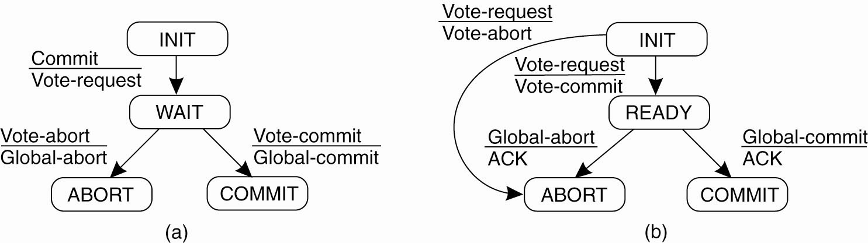
Two-Phase Commit (1)
Figure 8-18. (a) The finite state machine for the coordinator in 2PC. (b) The finite state machine for a participant.

Slide 27
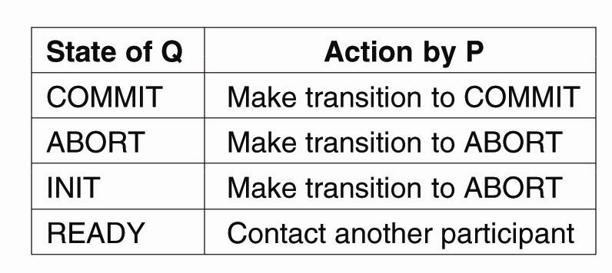
Two-Phase Commit (2)
Figure 8-19. Actions taken by a participant P when residing in state READY and having contacted another participant Q.

Slide 28
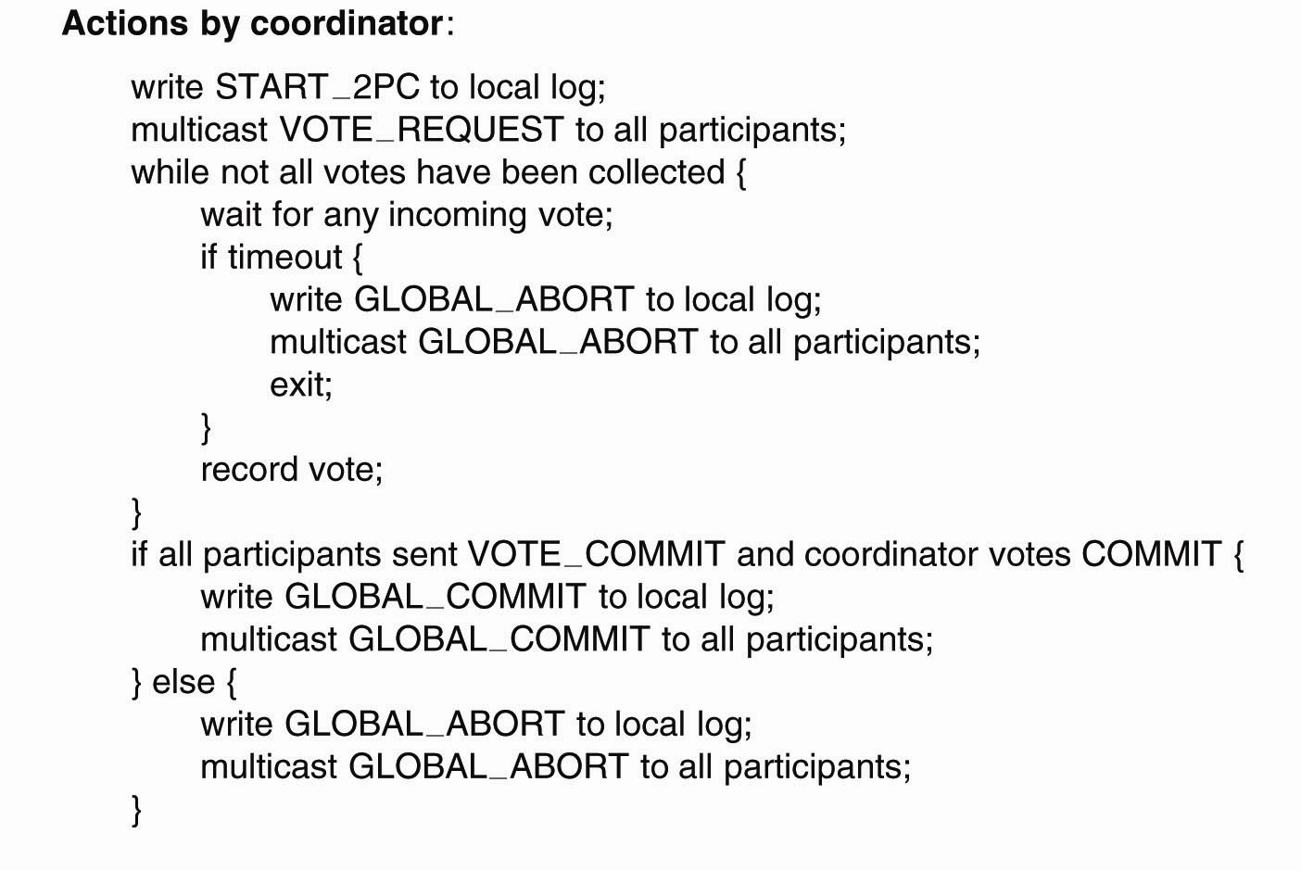
Two-Phase Commit (3)
Figure 8-20. Outline of the steps taken by the
coordinator in a two-phase commit protocol.
. . .

Slide 29
Two-Phase Commit (4)
Figure 8-20. Outline of the steps taken by the
coordinator in a two-phase commit protocol.
. . .

Slide 30
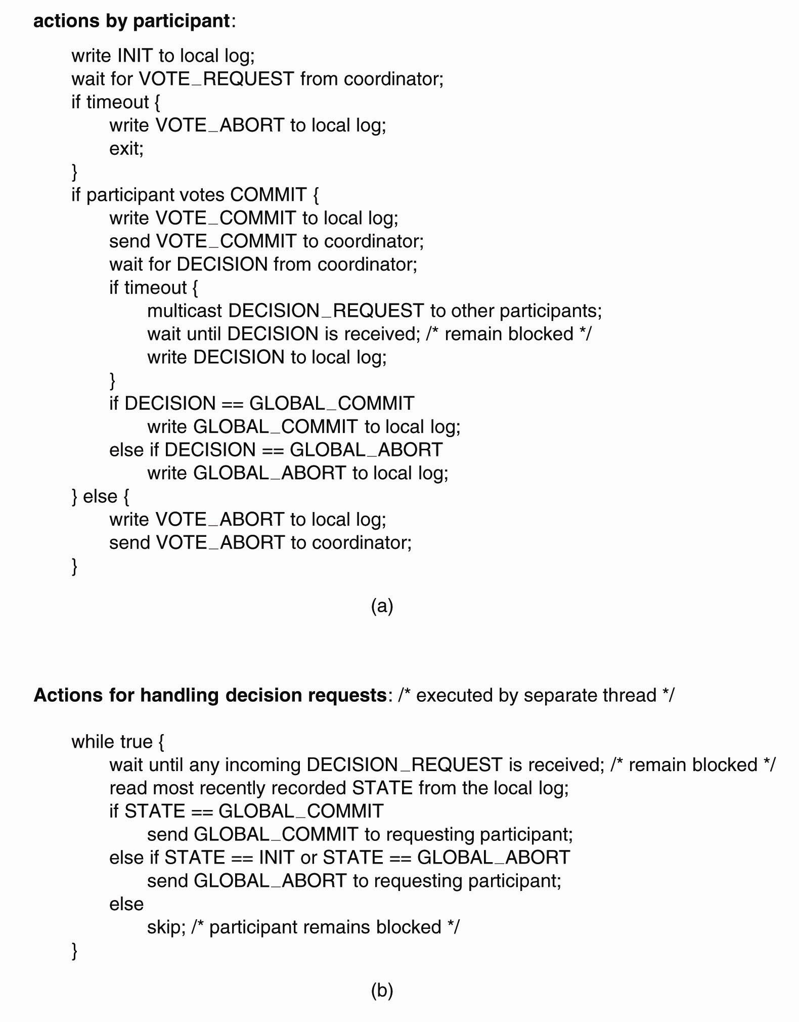
Two-Phase
Commit (5)
Figure 8-21. (a) The steps taken by a participant process in 2PC.

Slide 31
Two-Phase Commit (7)
Figure 8-21. (b) The steps for handling
incoming decision requests..

Slide 32
Three-Phase Commit (1)
The states of the coordinator and each participant
satisfy the following two conditions:
There is no single state from which it is possible to make a transition directly to either a COMMIT or an ABORT state.
There is no state in which it is not possible to make a final decision, and from which a transition to a COMMIT state can be made.

Slide 33
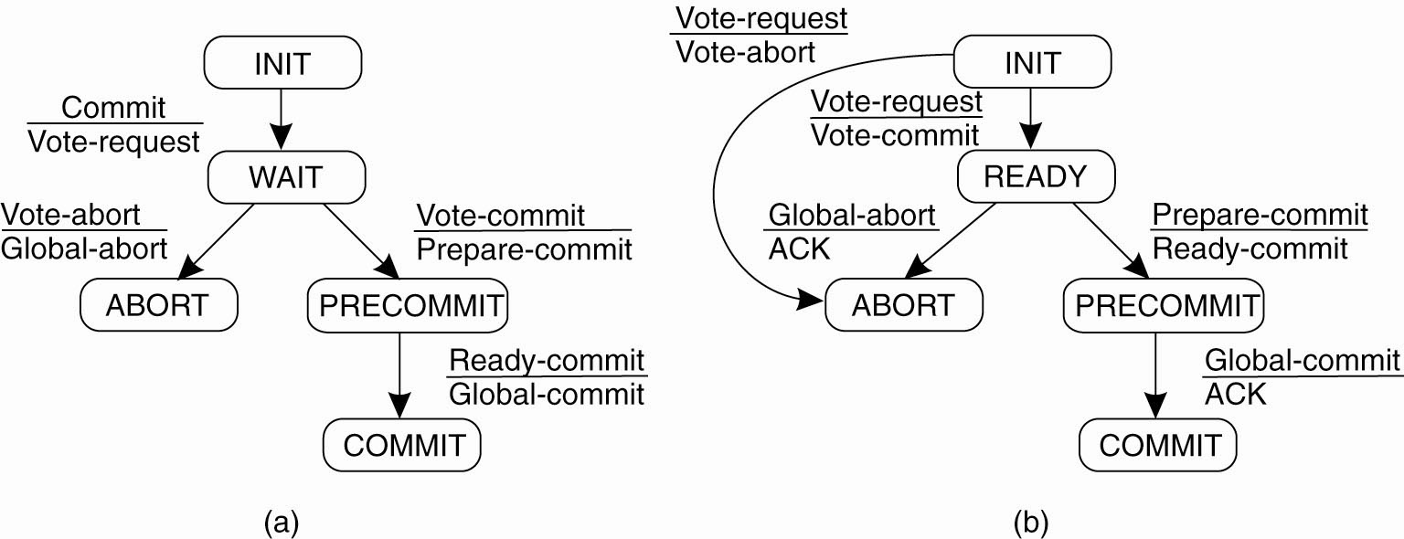
Three-Phase Commit (2)
Figure 8-22. (a) The finite state machine for the coordinator in 3PC. (b) The finite state machine for a participant.

